Slide 1
Applications of Electronics
Section 01
In this Section:
Introduction to the Unit
Electrical & electronic systems
Sensors and Signals
No Examples classes until week 3

Slide 2
Teaching & Learning
Teaching Block 1: Weeks 1-12
Two parts: analogue and digital
Analogue (Warr): wks. 1-5 (inc. Exa.c)
Digital (Dahnoun): wks. 7-12
No lectures in wk. 8
Learning reliant on self-study:
Reading relevant sections of textbook
Studying example questions

Slide 3
Lab Timetable – Analogue
AM: 10:00-13:00
PM: 14:00-17:00
Location: EE teaching Lab – QB0.09
 | Analogue 1 | Notes
Aero Groups 1-10 | Week 4, Monday 2-5pm
Aero Groups 11-20 | Week 5, Monday 2-5pm
Aero Groups 21-30 | Week 6, Monday 2-5pm
Mech Groups 6-10 | Week 3, Friday 10am-1pm
Mech Groups 11-15 | Week 4, Friday 10am-1pm
Mech Groups 16-20 | Week 5, Friday 10am-1pm
Mech Groups 1-5 | Week 6, Friday 10am-1pm
Eng. Maths | Week 4, Friday 2-5pm | To be informed
Eng. Maths | Week 4, Friday 2-5pm | by timetable
Civil | Week 5, Tuesday 2-5pm
Eng. Design | Week 4, Friday 2-5pm
The allocation of students to groups is released by departments.

Slide 4
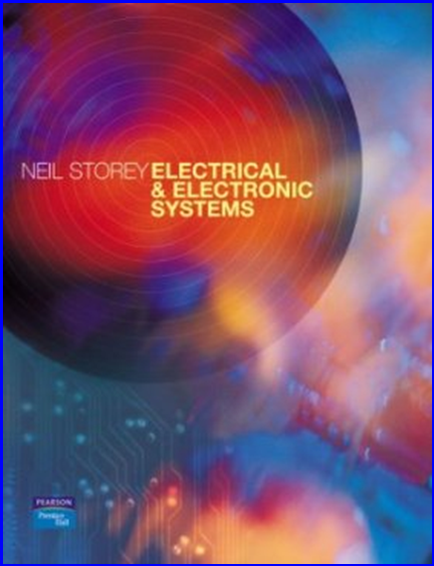
Text Book
Electrical and Electronic Systems, Neil Storey, Pearson Prentice Hall,
ISBN 0-13-093046-6.
University Library holds this book as an e-book
Should be ample licences
Let me know if you can’t get one
Reading and Exercises for each Lecture

Slide 5

Online Learning Support
‘Blackboard’ Online resources access
https://www.ole.bris.ac.uk/webapps/portal/frameset.jsp
Look for the unit code EENG16200
For the Analogue part:
Laboratory exercise notes
Pencasts - Realtime problems, solutions and discussion (synchronized audio and ink)
Slides and handouts are on the Blackboard site

Slide 6
Laboratory Activities
2 Analogue Lab sessions provide basic training in dealing with electronic systems and instruments.
Lab 1: Oscilloscope Skills
Lab 2: Characterisation of an Electronic Sensor System
Postgraduate lab demonstrators support your learning
Laboratory work carries 30% weighting, the remainder of the assessment is a multiple choice exam.
And now we start at the beginning

Slide 7
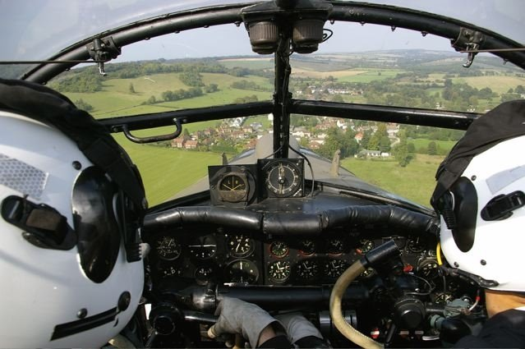
Early 20th Century System
Cockpit of a Lancaster bomber

Slide 8

Early 21st Century System
Mechanical
Hydraulic
Fly by wire
Cockpit of an A380

Slide 9
Hierarchy in System Design
Black box
Input
Output
Top Level System
What does it do?
What goes in?
What comes out?
How well does it do the job?
Function
Performance

Slide 10
Subsystems in a System
Input
Output
Open the big black box
We find more black boxes - subsystems
Each performing a sub-function
Connected together to provide the desired function & performance of the System

Slide 11
Electronic System
Engineering sub-systems for instrumentation and control are increasingly ‘electronic’ or ‘electrical’
As an engineer, you will need to deal with these subsystems
You will need to use them
You will have to specify them
You will also take part in configuring them
You will not need to design them

Slide 12
Specifications
The function & performance of the electronic/electrical sub-systems are defined by the system engineer
The configuration of the sub-systems are defined by discussion between the system engineer and the electronics/electrical engineer
The realisation of the electronic sub-system by electrical and electronics engineers (hardware and software)
The characterisation (function, performance, interface, reliability, emissions, form factor etc.) of a system and its subsystems is via
Specifications
which are documents containing statements

Slide 13
The systems approach
The systems engineer is concerned with
What systems do
How well they do it
How they link to form larger systems
And not really concerned with
How they do it
What happens inside each box

Slide 14
Electrical/electronic sub-system
EE systems use electricity:
Formally:
The ‘discipline’ is ‘electrical’
The ‘primitives’ are Voltage and Current
The same core design equations relate to electrical, hydraulic, pneumatic, gravitational, and magneto-static and other ‘disciplines’ which employ force and flow type parameters
Example:
Control Loop
rotating shaft
angle
sensor
EE system
actuator

Slide 15
Sensors
1 V
voltage
0
0
360
Angle (degrees)
Sensors monitor a physical quantity
Sensors output an electrical signal as a known function of the physical quantity being monitored

Slide 16
Types of electrical sensors
Sensors that change their electrical parameter according to the physical quantity:
Resistive sensor: resistance changes
Inductive sensor: inductance changes
Capacitive sensor: capacitance changes
Sensors that generate electrical energy from other forms of energy:
Photoelectric: light to electrical energy
Piezoelectric: strain to electrical energy
Inductance: magnetic field energy to electrical energy
Capacitance: electric field energy to electrical energy
The electrical output of a sensor carries information
The information content is called a ‘signal’
The signal is processed by the electronic system
The output could be an instrumentation or an actuation

Slide 17
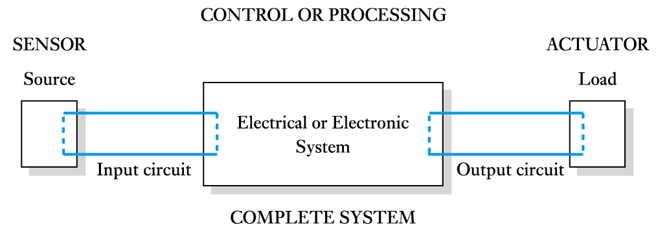
Interfacing sensors to electronic systems – the key content of this unit
Due to the very different ways sensors work, there is no standard sensor interface
We will cover a few typical ways of sensor interface in this unit.
But first, some basics of the electrical system

Slide 18
Signals from sensors
0.001 V
voltage
0
0
270
Angle (degree)
Sensors share several common features:
They produce small amounts of signal
Insufficient power drive actuators
The signals they produce are never a perfect reflection of the associated quantities
Noise, interference and distortion
Such signals must be processed to retrieve the desired information and to cause the correct action or instrumentation

Slide 19
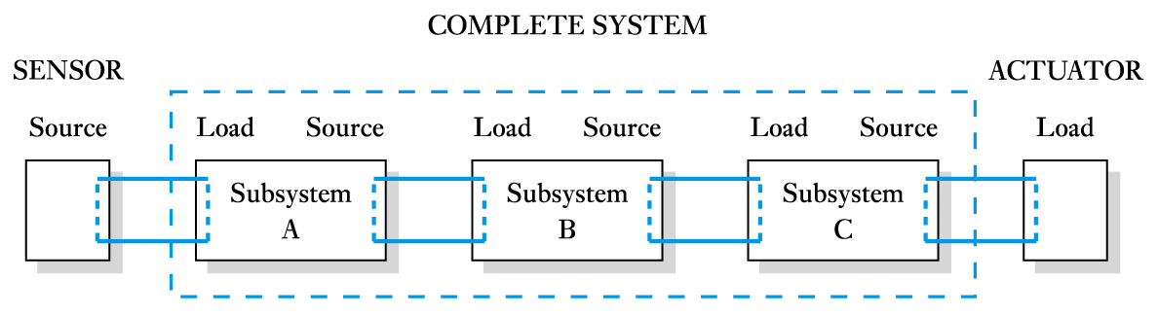
Important signal processing functions in electronic systems
Amplification: increasing current, voltage and/or power of a signal
Filtering: Removal of unwanted noise and interference
Interpretation: Extracting the useful information from the signal
Display: Representing the information to humans (instrumentation)
Storage: Keeping the information for reference
Actuation: initiating action according to the information
This unit covers the basics about these important functions

Slide 20
Energy and Electrical Power
Electrical Systems generate, manage and deliver energy
They power electronic systems, mechanical systems, hydraulic systems, etc.
Power supply

Slide 21
Key points of this section
Electronic and electrical systems are ubiquitous elements of all modern engineering systems
Sensing, processing, decision making, and actuation maybe (and usually, are) performed by electronic systems
Nearly all tests and diagnostics involve electronic systems
Knowledge of particular applications are built into electronic systems by information storage
A ‘signal’ is the key thing that flows through an electronic system
This unit equips you with the basic knowledge to interact with EE engineers, to specify, and to use EE systems.

Slide 22
Reading and Exercises
Chapter 3
3.1 Types of sensors: read in detail
3.2 Describing sensor performance: read in detail
3.3 to 3.8: Examples of sensors – scan read
Exercises 3.1 – 3.5: answer the questions in your mind, go back over the relevant sections if necessary. There is no need to write the answers if you are confident that you understand the concepts.

Slide 23
Applications of Electronics
Section 02
In this section :
Voltage, current, resistance
Lumped circuits
Ohm’s and Krichhoff’s laws for lumped circuits
Series circuit and potential divider
Parallel circuit and current divider
Physical quantities and units
Electrical signals

Slide 24
Easy bits and assigned work
This lecture outlines the basics of Electrical Circuits
For most students much of this will be familiar
The following lectures will assume a basic understanding of these topics
Reading and Exercises:
Chapter 2: Scan read the Chapter and make sure you understand Examples 2.6 and 2.8
Exercises: Carry out Exercise 2.12 - 2.17
Guide for exercises: First identify groups of resistors that are in series or parallel, work out their equivalent resistance. Replace this group with the equivalent resistance. Then see how these equivalent resistances are connected and work out the final equivalent resistance (answers are in Appendix E)

Slide 25
Electrical Circuits
Electric charge - an amount of electrical energy
The charge held by one electron is -1.6x10⁻¹⁹ Coulomb
Charge is either positive or negative
Electric current
A flow of electric charge, commonly a flow of electrons
Conventional current flows from positive to negative voltage
The negatively charged electron physically moves in the opposite direction to the conventional flow of charge
Current flow in a circuit
A sustained current needs a complete circuit (closed loop)
And requires a stimulus to cause the charge to flow

Slide 26
Gravitational potential and water flow
Energy out of system
Turbine
The water in the top tank has a higher gravitational potential energy than that in the bottom tank. This creates a difference in the stored energy in the two masses of water. This energy is given up in the turbine as water flows from the higher potential state to the lower potential state
Energy into system
Potential energy difference
Pump
The motive force of the pump transduces energy into the system which is held the by the mass at the higher gravitational energy state
The water flows and transfers this energy to the turbine which transduces energy out of the system

Slide 27
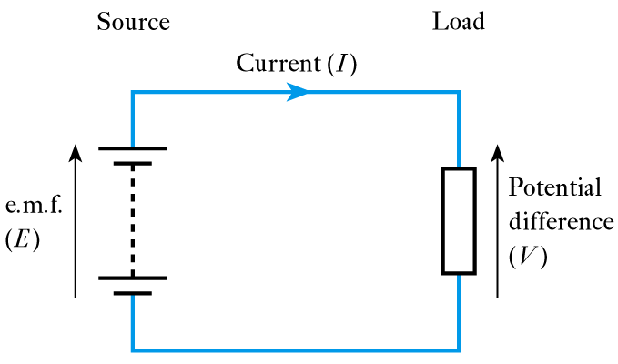
The electrical discipline version
The equivalent of the pump is an electromotive force – e.m.f. (E)
The equivalent of the gravitational field is the electric field in which the potential difference is measured in Volts (V)
The equivalent of the water is charge, the flow of charge is called current (I)
The equivalent of the turbine is the resistor (R) which converts electrical energy into heat energy
R

Slide 28
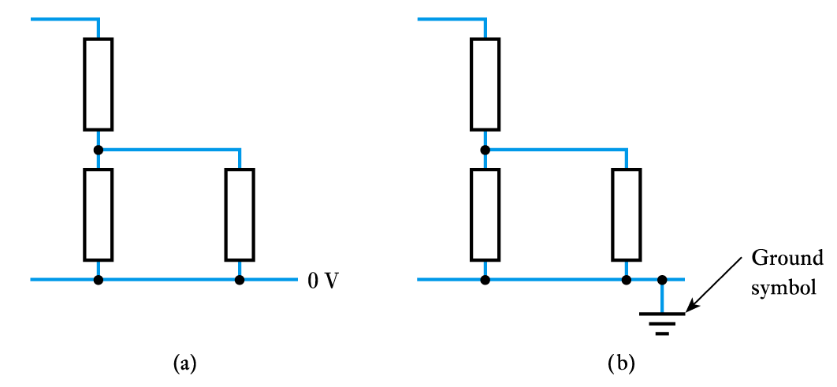
Voltage reference points
All potentials within a circuit must be measured with respect to some other point
We often measure the potential difference (voltage) across an element
We also often measure voltages with respect to a common zero-volt reference called the ground or earth
1V
0.5V
R₁
0.5V
1V
R₂
R₃

Slide 29
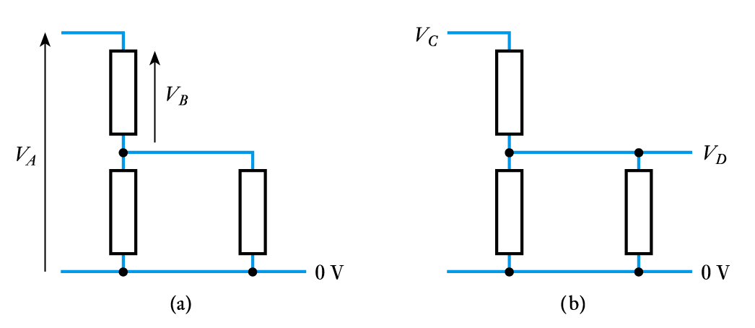
Representing voltages in circuit diagrams
Conventions vary around the world
We normally use an arrow, which is taken to represent the voltage on the point with respect to the flat end
We also use labels to represent voltages with respect to earth

Slide 30
Direct Current and Alternating Current
Currents in electrical circuits may be constant or may vary with time
When currents vary with time they may be unidirectional or alternating
When the current flowing in a conductor always flows in the same direction this is direct current (DC)
When the direction of the current periodically changes this is alternating current (AC)

Slide 31
Resistors, Capacitors and Inductors
Resistors provide resistance
they oppose the flow of charge
measured in Ohms (Ω)
Capacitors provide capacitance
they store energy in an electric field
measured in Farads (F)
Inductors provide inductance
they store energy in a magnetic field
measured in Henry (H)
We will look at each component in later lectures

Slide 32
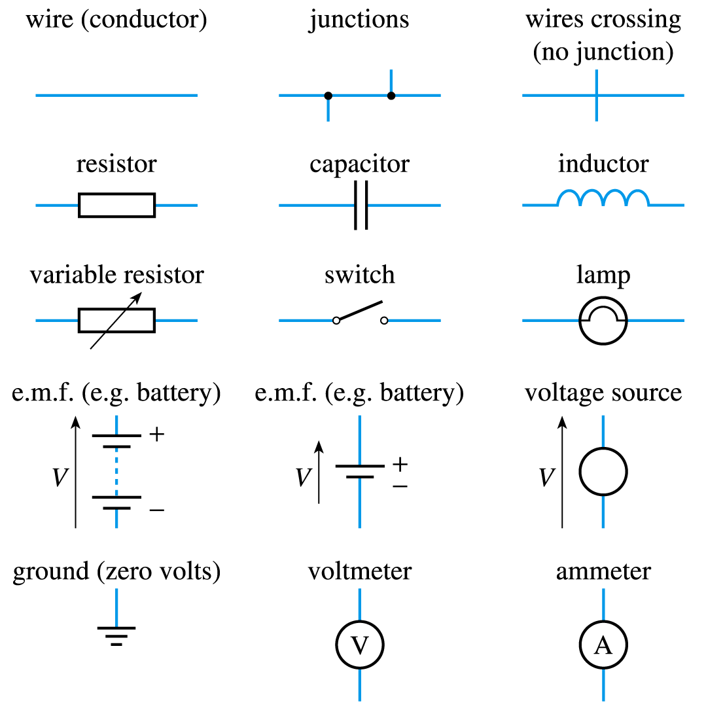
Circuit Symbols
These symbols are taken from the text for this unit.
The lecturer doesn't like the inductor being blue
The single-cell battery is incorrect

Slide 33
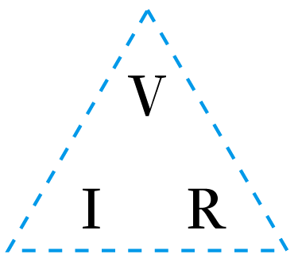

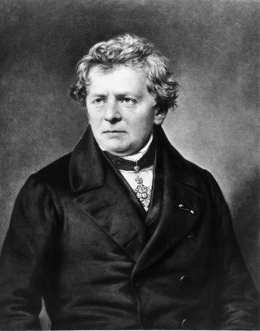
Ohm’s Law: characteristics of resistors
The current flowing in a conductor is directly proportional to the applied voltage, V, and inversely proportional to its resistance, R
I
V = IR
I = V/R
R = V/I
Shamelessly copied from Wikipedia
Georg Simon Ohm (1789–1854) was a German physicist and mathematician

Slide 34
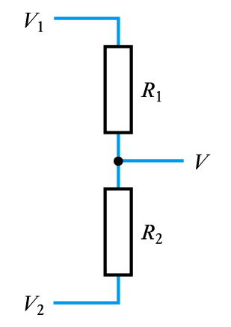
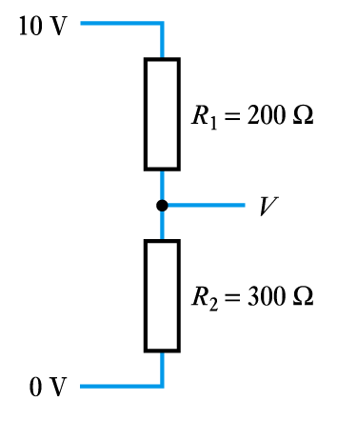
Resistive Potential Dividers
The voltage (V₁-V₂) (potential difference) is divided between the two resistors.
Note: V, V₁ and V₂ here are all referred to ground (or 0V)

Slide 35
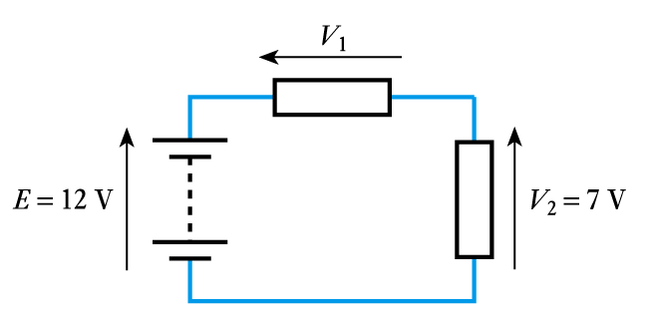
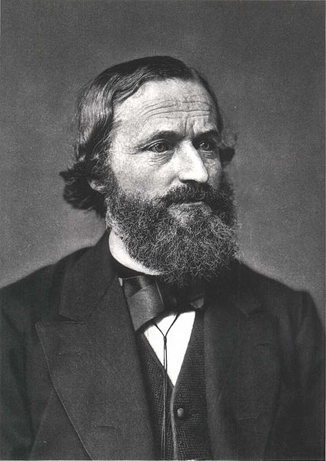
Kirchhoff’s Voltage Law (KVL)
The algebraic sum of the voltages around any loop in a circuit is zero
E – V₁ – V₂ = 0
V₁ = E – V₂
= 12 – 7
= 5 V
KVL states that a charge moving around a closed loop back to its starting point has neither gained nor lost energy
Shamelessly copied from Wikipedia
again
Gustav Robert Kirchhoff (1824–1887) was a German Physicist

Slide 36
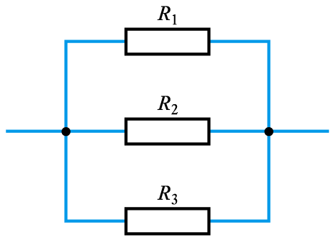
Resistors in parallel
I₁
I
I₂
I₃
V
The inverse of resistance is called conductance

Slide 37
Resistive Current Dividers
I
I₁
I₂
V
R₁
R₂

Slide 38
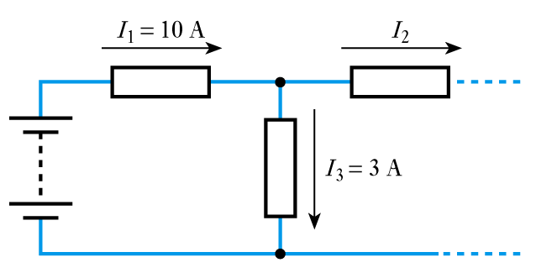
Kirchhoff’s Current Law (KCL)
The algebraic sum of the currents flowing into any junction in a circuit is zero
For the red node below
I₁ – I₂ – I₃ = 0
I₂ = I₁ – I₃
= 10 – 3
= 7 A
KCL states that charge will neither be created nor annihilated at any junction in a circuit

Slide 39
Power Dissipation in Resistors
Resistors convert electrical energy to heat
The instantaneous power dissipation, P, of a resistor is given by the product of the voltage across it and the current passing through it.
Combining this result with Ohm’s law gives:
P = VI
P = I²R
P = V²/R

Slide 40
Key Points so far
The driving force that makes electric current flow is the e.m.f., or potential difference, or voltage.
P.D., e.m.f., E, can all be called Volts (V) in a lumped element circuit
Ohm’s Law and Kirchhoff’s Laws are fundamental to lumped element circuit calculations

Slide 41
SI Units
Quantity | Quantity symbol | Unit | Unit symbol
Capacitance | C | Farad | F
Charge | Q | Coulomb | C
Current | I | Ampere | A
Electromotive force | E | Volt | V
Frequency | f | Hertz | Hz
Inductance (self) | L | Henry | H
Period | T | Second | s
Potential difference | V | Volt | V
Power | P | Watt | W
Resistance | R | Ohm | Ω
Temperature | T | Kelvin | K
Time | t | Second | s

Slide 42
Common Prefixes
Prefix | Name | Meaning (multiply by)
T | tera | 10¹²
G | giga | 10⁹
M | mega | 10⁶
k | kilo | 10³
m | milli | 10⁻³
μ | micro | 10⁻⁶
n | nano | 10⁻⁹
p | pico | 10⁻¹²
So: 1MΩ=10⁶ Ω, 10nF=10⁻⁸ Farad, 1mH=10⁻³ Henry

Slide 43
Signals – types and description

Slide 44
Physical Quantities & Signals
The world about us is characterised by a number of physical properties or quantities
e.g. temperature, pressure, humidity, etc.
Physical quantities may have continuous or discrete values in the time domain
Continuous quantities change smoothly with time and can take an infinite number of values
Discrete quantities change abruptly (modelled as instantaneous) from one value to another
most real-world quantities are continuous at the human scale
many man-made quantities are discrete
Signals may be described as functions in the time domain or in the frequency domain

Slide 45
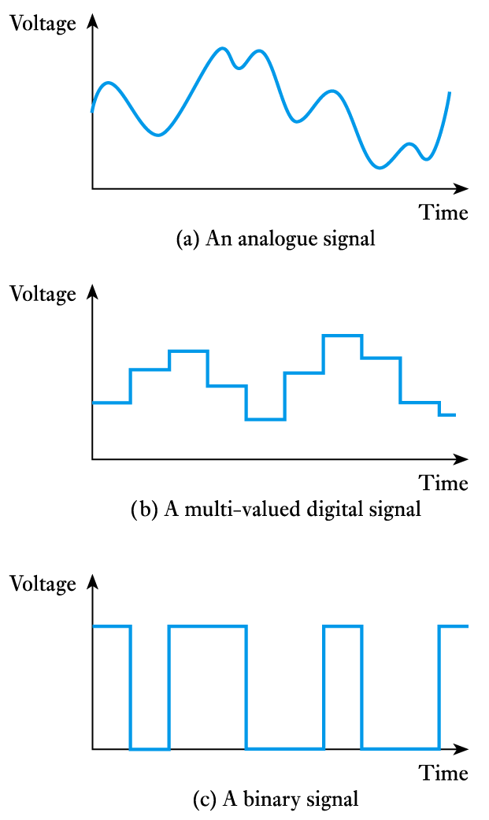
Time-domain description
Constant signals
It is easy to comprehend a function of time
Electrical signals can represent time varying quantities (continuous or discrete)
We call this a waveform
Continuous signals are often described as analogue
Discrete signals are often described as digital (more later)

Slide 46
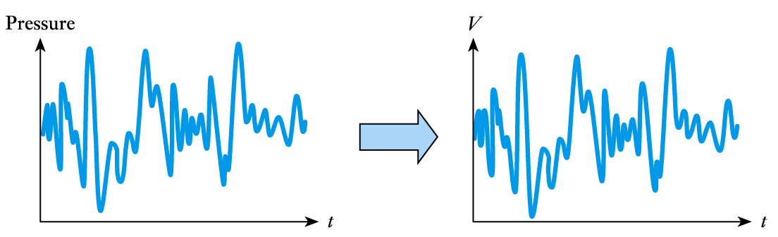
Analogue Signals
Analogue electrical signals (waveforms) are continuous and can take an infinite number of values
They have been used since the 19th century
e.g. in telephone and wireless communication
In most electrical systems, a voltage represents the amplitude of some physical quantity and varies in the time domain as the quantity changes
sensor
Alternatively, current is sometimes used

Slide 47
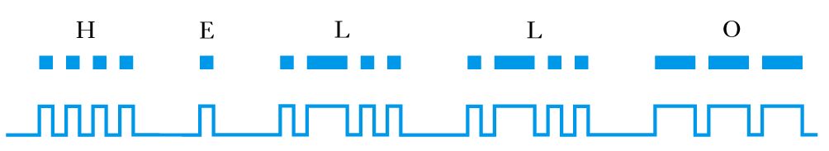
Digital Signals
Many digital signals take only two values and are referred to as binary signals
These digital signals are the subject of the other half of the Applications of Electronics unit
Digital signals have also been used since the 19th century
e.g. in telegraphy
using Morse code

Slide 48
Analogue Signals
- description and characteristics
Section 03
Metrics for Analogue
Signals
Periodic and
non-periodic
waveforms
Learning Activities for
this section:
Assigned Reading
Chapter 5, sections 5.1, 5.2
Exercises: 5.1-5.3, 5.12

Slide 49
Signals in Electrical/Electronic systems
A signal is an electrical ‘primitive’ (voltage or current) that represents a physical quantity – Q
e.g., for a voltage representing a quantity
v=f(Q) where f is a known function

Slide 50
Physical Quantities & Electrical Signals
sensor
Physical quantity
Signal
t
f
t
t
t
There are two ways to describe a signal
Time Domain description
Frequency Domain description
Notes:
The world around us is characterised by a number of physical quantities
e.g. temperature, pressure, humidity, etc.
Physical quantities may be continuous or discrete.
Continuous quantities change smoothly and can take an infinite number of values
Discrete quantities change abruptly from one value to another.
most real-world quantities are continuous
many man-made quantities are discrete
We can convert continuous quantities into discrete quantities.

Slide 51
Time-domain description
It is intuitive and natural to describe the signal as a function of time
Commonly, the signal is depicted as the ‘tangential motion’ of the waveform as it progresses linearly through time representing the variation of the physical quantity in time

Slide 52
Constant or ‘DC’ signal
Voltage
V₀
Time, t
There is no change to the signal amplitude as time progresses

Slide 53
Analogue signal
Continuous signals are often described as analogue because their variation is analogous to the physical quantity it represents.
Analogue signals are free from discontinuities and can take an infinite number of values.

Slide 54
Amplitude Characteristics of Analogue Signals: Mean (average) value of a signal
This analogue waveform is non-periodic i.e., it does not repeat in time
The mean is estimated by integrating over a ‘long’ time
v(t)
t₁
t₂
The Mean value ( ) is the value about which the signal perturbs (varies)
The mean value is also called the ‘DC’ component of a signal.
Upper case ‘V’ implies a value which does not change in time

Slide 55
Direct and Alternating: The ‘DC’ and ‘AC’ parts of a signal
v(t)
Lower case ‘v’ implies a value which does change in time
v(t)
V_{DC}
v_{AC}
The v_{AC} part has the same waveform as v(t), but has zero average value.
The varying part of a signal carries the information, the DC is often removed at some part of the analogue signal processing
t

Slide 56
Periodic signal example: A Sine waveform
Where
v
T
t
This analogue waveform is periodic i.e., it does repeat in time
The mean (V_{DC}) of this waveform is found accurately by integrating over a whole number of periods – this number can be 1
Notes:
V₀ is the amplitude of the sine wave, ω is called the angular speed, f is the frequency of the sine wave, T is its period, φ is its phase.

Slide 57
Periodic signal example: Sine waveform with DC component
v
V_{DC}
t
This is often found when a system or circuit does not support negative signal value
Notes:
V₀ is the amplitude of the sine wave, ω is called the angular speed, f is the frequency of the sine wave, T is its period, φ is its phase.

Slide 58
Positive-signal-only example: a sine waveform passing a diode circuit
input
output
input
0V (ground)
output
v
v
V_{DC}
0V (ground)
t
0V (ground)
t

Slide 59
Range of a signal
The range (also known as peak-to-peak value) gives the range of values a waveform can take
Dynamic range is the difference between the largest and smallest usable signal
A ‘long’ observation time is needed for this non-periodic signal to be sure of the range
The longer the observation time, the more statistical relevance to the metric of range
v(t)
V_{max}
V_{min}

Slide 60
Energy Conversion and Power:
When a voltage or current is applied to a resistor, R, the rate of energy conversion (power), P, is
i
v
If the V or I is varying:
R
At any point in time, t, the instantaneous power is:
Average power over a given time is:

Slide 61
Magnitude Metrics for Signals
Mean (Average, DC) value
Peak-to-peak amplitude (range, AC value)
power-related amplitude metric: r.m.s.
(root of mean squared)
This is the equivalent amplitude of a DC-only signal for which a resistor will dissipate energy heat at the same rate (power)
For the special case of a sine waveform:
V_{r.m.s.} =V_{0-pk}/√2 I_{r.m.s.} =I_{0-pk}/√2

Slide 62
Rate of signal waveform variation with time
v
T
t
Where
For sine waves this is characterised by its frequency f, or period T ,and its amplitude, V₀
Recall: this is a periodic signal because it repeats itself at regular time intervals, T
The frequency f=1/T is the number of waveform period repetitions in 1 second

Slide 63
Rate of Variation: Other periodic signals
T
Slew rate = ∞
Square wave
Triangular wave
All periodic signals are characterised by a period T
The periodic signal frequency is still defined as f=1/T
However, unlike the sine wave, T and amplitude do not completely tell us how fast these waveforms change with time.
The slew rate of these two signals is quite different
Slew rate

Slide 64
Rate of variation: Non-periodic signals
v(t)
In this case the concept of period or frequency does not apply as there is no repetition in time
Slew rate (SR) can still be defined because it is the maximum rate of change
The signal must be observed for a ‘long’ time in order to establish its maximum rate of change
The slew rate can not be found mathematically as it can in the case of periodic waveforms
Non-periodic analogue waveforms are best described statistically as their instantaneous value has a probability distribution: more of this later

Slide 65
Signals and Systems
Section 04
Time and frequency domain description of signals
Linear system characteristics
Learning Activities for this section
Assigned Reading
Chapter 5, sections 5.4, 5.5
Exercises: 5.14 -5.18

Slide 66
Sine wave:
The fundamental simple shape
ω (rad/s)
V_{p}sin (ωt)
ωt
t=0
t
V_{p}cos (ωt)
V_{p}
ωT=2π
t=nT
N=0,1,2,3…
The endless circular movement of a point at a constant angular velocity, ω
Sine waves can be expressed in the Cartesian plane by rotating vectors called phasors

Slide 67
Phase and phase shift
ω (rad/s)
φ
τ=φ/ω
ωt
t=0
φ
V_{p}
The absolute phase of one sine wave is dependent on time.
The phase difference (known as ‘phase shift’) between two sine waves of the same frequency is a key parameter in many electronic systems.

Slide 68
The relation between two sine waves
τ
T
V₂
lagging
V₁
t
voltage
0
leading
Phase shift
The units are radians
(2π radians = 360º)
Convention dictates that the phasors which represent sine waves rotate anti-clockwise in time; so the black phasor is leading the lagging red phasor by τ seconds and equivalently φ radians.

Slide 69
Phasor diagrams
In this phasor diagram which represents two sine waves:
The magnitudes of the sine waves are V₁ and V₂
The phase difference between them is
V₂
φ
V₁
φ
Phasors are used to represent sine waves but, more importantly, the relationship between two sine waves
A phasor is a rotating vector
The angle between the phasors indicates the phase shift between the sine waves they represent
The length of a phasor indicates the magnitude of the sine wave it represents
Voltage, current, and other quantities may be merged on the same phasor diagram
As phasors are rotating at the same angular velocity, the fact that they are rotating may be ignored

Slide 70
Linear System response to a sine wave input
Sine input
Sine output
Linear
System
Different phase and magnitude
If a sine wave is the input to a linear system, then the output waveform (and the waveform at any point inside the system) is also a sine wave of
the same frequency
However, relative to the input waveform, the output waveform will generally
have different amplitude and phase
The amplitude and phase response of a linear system may be different for different frequencies of sine wave input waveforms

Slide 71
Frequency Domain Description of Signals
Any waveform may be built by adding sine waves of different frequencies, amplitudes and phases
A general signal will have a continuous spread of different frequencies across a range
A periodic waveform can be built using sine waves that are equally spaced in frequency
The lowest frequency of the sine wave components has the same period as the periodic signal
All other sine waves have frequencies that are integer multiples of the lowest frequency sine wave component

Slide 72
Periodic Signal Example: A square-shaped Waveform
t
Amplitude
f
f₀
2f₀
3f₀
4f₀
5f₀
6f₀
7f₀
Frequency
The frequencies which can be used to make up a periodic waveform are called Harmonic Components
Here, only the amplitude of each harmonic is shown.
The Phase of each harmonic component is also important in composing the original waveform.
For the square wave the harmonic components are of odd-order only

Slide 73
Frequency Components of a Square Waveform
In the figure below the 5 lowest frequency harmonics
For a square wave they all have the same phase at t=nT, n=0,1,2,3,..
time

Slide 74
Demonstration of how harmonics can compose a waveform
‘Fundamental’
component - (1st harmonic)
1st and 3rd order
harmonic component
time
time
(There is no 2nd harmonic component in a square wave )

Slide 75
Demonstration of how harmonics can compose a waveform
1st , 3rd and 5th order
harmonic component
1st , 3rd , 5th and 7th order
harmonic component
time
time

Slide 76
Demonstration of how harmonics can compose a waveform
1st , 3rd , 5th , 7th and 9th
order harmonic component
1st to 19th order harmonic component
time
time

Slide 77
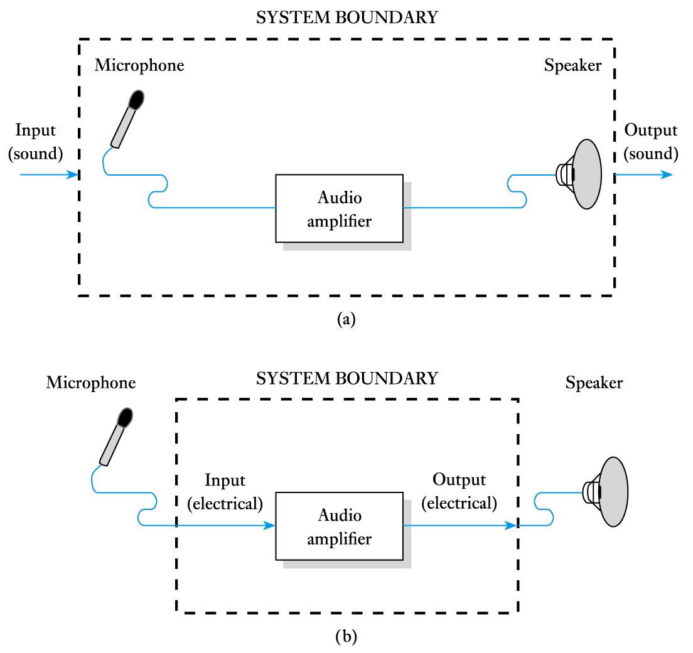
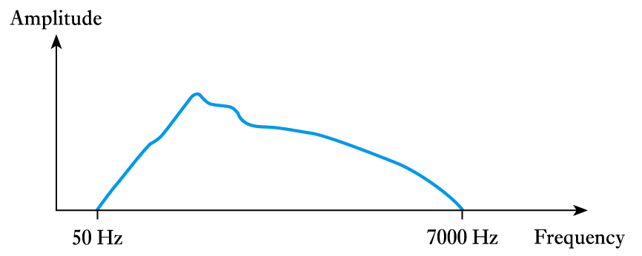
Frequency Range of a Signal
The human voice has magnitude of content in the range of
50 Hz – 7 kHz
The frequency domain view of a signal is called the
Frequency Spectrum
1
0.707
A frequency spectrum for a speech waveform

Slide 78
Bandwidth of a Signals and Systems – needed for Lab1
The difference between the half-power frequencies of a signal is termed its bandwidth
For example:
a typical human voice has a frequency range from 50 Hz to 7 kHz. The power of the signal content at these two frequencies has reduced to half that of the mid-range
Therefore: Bandwidth = 7 kHz – 50 Hz = 6.95 kHz ≈ 7 kHz
Half Power = -3dB or when V=Vmax/√2
The bandwidth of a system is the frequency difference between the half-power points
A system may reduce the bandwidth of a signal passing through it
A system may have a frequency range extending down to 0 Hz

Slide 79
Characteristics of Linear Systems
In a linear system
There is a linear relation between output and input waveform magnitudes at each frequency point
There is a linear relation between output and input waveform phases at each frequency point
R and Δφ may be different for different frequencies and so are functions of frequency and
Consequently, a system may alter the time domain ‘shape’ of a waveform by changing the amplitude and phase of each of the frequency components in it

Slide 80
Low-Pass Filter: Attenuates and phase-shifts higher frequency signal components
t
Amplitude
Amplitude response, R(f), of a low-pass filter
f
f₀
2f₀
3f₀
4f₀
5f₀
6f₀
7f₀
f
f₀
2f₀
3f₀
4f₀
5f₀
6f₀
7f₀
t

Slide 81
Low-Pass Filter: A linear system
Low pass filter
(linear system)
R
R(f) is called the
amplitude response
Together they are called
The Frequency Response,
which characterises a linear system
f
φ
f
Δφ(f) is called the
phase response

Slide 82
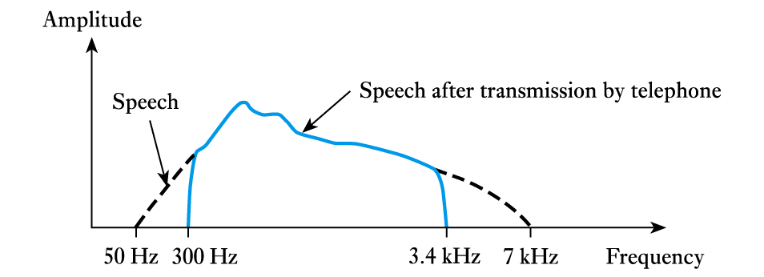
Frequency response of a system
All systems impose restrictions on the signals that can pass through them
usable frequency range is determined by the frequency response of the system
Frequency response of telephone system
Bandwidth

Slide 83
Electrical sources
Section 05
Electrical sources
Power Sources
Signal Sources
Characteristics of electrical sources
The application of a load to a source
Models of sources
Thévenin model of a source: Ideal Voltage with series Resistance
Norton model of a source: Ideal Current with parallel Resistance
Conversion between the two source models
Energy delivered to a load:
Power matching
See the final slide for the learning
activities for this section

Slide 84
Sources: power and signal
Two types of sources in an electronic system:
A power source provides energy
A signal source provides information
The system ‘loads’ these sources
As a power load or a signal load
Signal sources may provide energy to the system
The power (rate of change of energy) is generally very small if the source is a sensor
Infinite or zero resistance loads take no energy from a source
Both voltage and current are required to transfer energy (P=IV)
Power
Source
Signal
Source
Signal
Load
Electronic system

Slide 85
Types of sources
Types |  | Voltage source: supplies a ‘constant’ voltage | Current source: Supplies a ‘constant’ current
properties | Independent | Voltage or current value doesn’t depend on any other voltage or current in the circuit
 | dependent | Voltage or current value depends on an other voltage or current in the circuit
 | Ideal | Voltage source has zero resistance, current source has infinite resistance i.e., the application of a load does not change the value
 | Non-ideal | The source has a resistance (series for V-source and parallel for I-source). This means that the voltage or current seen by the load is dependent on the load resistance

Slide 86
Ideal voltage and current sources
Ideal voltage source:
Output voltage is constant regardless how much current it delivers (to the logical extreme, this includes 0 Ω.
Power:
P(Watts)=Volts x Amps
With ideal sources voltage or current can be infinite whilst the other primitive is finite. Thus Power may be infinite. Clearly, these are unrealisable in practice and so a more practical model is required
10 V
Ideal current source:
Output current is constant regardless of the voltage it delivers (to the logical extreme, this includes
∞ Ω
2 A
Other symbols
Current
Source
Voltage
Source

Slide 87
V-I characteristics of a practical source
I_{L}
+
source
R_{L}
V_{L}
-
Practical sources have an internal resistance
The output of a current source will have less dependency on voltage across its load resistance as its internal resistance increases
The output of a voltage source will have less dependency on current delivered to its load resistance as its internal resistance decreases
Sweep the value of a load resistance applied to a source and measure the current to find the source resistance

Slide 88
Non-ideal (Practical) Voltage Source
Practical Voltage
Source
I_{L}
V_{s} is the desired ideal voltage. As the current is increased, the output voltage, V_{L}, decreases due to the voltage drop across the internal resistance, R_{s}
If R_{s} = 0, the voltage source is ideal
+
R_{s}
+
-
V_{s}
V_{L}
V_{L}
-
V_{s}
ideal
practical
R_{s}=|dV_{L}/dI_{L}|
I_{L}
V-I characteristics

Slide 89
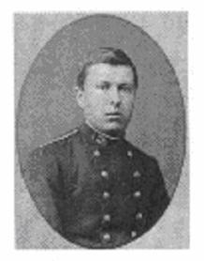
Thévenin’s Theorem
An entire electrical system connected to two terminals, A and B, can be replaced by a single voltage source V_{th} in series with a resistance R_{th}
Such a model of a source of electrical energy is called a ‘Thévenin equivalent source’
V_{th} is the ‘open circuit’ voltage between the two terminals (i.e., when no load is connected between A and B)
R_{th} is given by the rate of output voltage decrease with current increase
Léon Charles Thévenin (1857-1926) was a French telegraph engineer who extended Ohm’s Law to the analysis of complex electrical circuits
Shamelessly copied from Wikipedia

Slide 90
Thévenin Equivalent circuit of a source
A
R_{th}
Ideal
V_{th}: Voltage value between points A and B when I_{L}=0 (i.e., load is ‘open circuit’, R_{L}=infinite)
R_{L}
V_{th}
+
-
Load
Recall that when no current flows through a
resistor, there is no voltage drop across it
Ideal
B
Model of a practical
voltage source using
ideal components
R_{th} is the resistance value seen between points A and B.
Recall that an ideal voltage source has
zero internal resistance
R_{th}= |dV_{L}/dI_{L}|

Slide 91
Non-ideal (Practical) Current Source
I_{s} is the desired ideal current. As the voltage, V_{L} , is increased, the output current, I_{L}, decreases due to the current flow through the internal resistance, R_{s}
If R_{s} = ∞, the current source is ideal
I_{L}
Practical Current
Source
+
I_{s}
R_{s}
V_{L}
I_{L}
I_{S}
-
ideal
G_{s}=|dI_{L}/dV_{L}|
practical
V_{L}
I-V characteristics

Slide 92
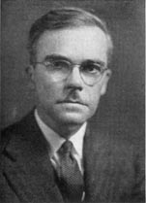
Norton’s theorem
An entire electrical system connected to two terminals, A and B, can be replaced by a single current source I_{N} in parallel with a conductance G_{N} (or resistance R_{N}=1/G_{N})
Such a model of a source of electrical energy is called a ‘Norton equivalent source’
I_{N} is the ‘short circuit’ current when terminals A and B are connected together
G_{N} is given by the rate of output current decrease with voltage increase
Edward Lawry Norton (1898-1983) was an accomplished Bell Labs engineer
[Also attributed to -
Hans Ferdinand Mayer (1895-1980) German mathematician and physicist]
Shamelessly copied from Wikipedia
(again)

Slide 93
The divide between voltage and current source is artificial
V
ideal
I
Slope = dV/dI =-R
Slope = dI/dV =-1/R=-G
I
V
The same source may be described by a Thévenin equivalent, or a Norton equivalent

Slide 94
‘Good’ signal sources tend towards one of the types
dV_{L}/dI_{L}= 0
for an Ideal Voltage Source
dV_{L}/dI_{L} is ‘small’ for a ‘good’ Voltage Source
dI_{L}/dV_{L}= 0 for an Ideal Current Source
dI_{L}/dV_{L} is ‘small’ for a ‘good’ Current Source
Ideal voltage source
V
Ideal current source
I
Many electrical sources are complicated circuits
Yet they can always be represented by a simple equivalent circuit model such as the Thévenin model or the Norton model

Slide 95
Thévenin-Norton Conversion
A
R_{th}
+
A
+
R_{L}
V_{L}
I_{N}
V_{L}
G_{N}
R_{L}
V_{th}
+
-
-
-
B
B
These are the equivalent circuits of the same source; therefore, it is possible to convert between them
Applying the methods of finding the Thévenin equivalent to the Norton circuit, we get
Open circuit voltage: V_{th}=I_{N} × R_{N} =I_{N}/G_{N}
Resistance (slope of the V-I curve): R_{th}=R_{N}=1/G_{N}

Slide 96
Condition for maximum power from a practical voltage source
V
R_{th}
R_{L}
V_{th}
+
-
I
P_{L} reaches maximum when R_{L} =R_{th} so
Current 1to9 as Voltage 9to1: 1x9 2x8 3x7 4x6 5x5 6x4 7x3 8x2 9x1

Slide 97
Power matching:
R_{th}
Power matching:
The load obtains maximum energy per unit time (power) from the source when:
load resistance = source internal resistance
This is required for the energy-generating class of signal sources which have mid-range resistance and for driving actuators
At this point, half of the total power is delivered to the load. The other half is consumed by the internal resistor
R_{L}=R_{th}
V_{th}
+
-
When it is necessary to amplify both current and voltage, both primitives must be passed to the amplifier
In the next lecture we will examine the requirements for Voltage amplification without Current amplification and Current amplification without Voltage amplification

Slide 98
Learning Activities for this Section
Assigned Reading
Chapter 12, sections 12.3, 12.4, 12.8
make sure you can follow examples 12.3, 12.4
Exercises: 12.5, 12.12
Kick-off for 12.12(a):
Rth=(200Ω//50Ω)+60Ω
(the resistance of the ideal voltage source is 0Ω)
Vth=10V x (50Ω /(200Ω +50Ω))
(no current flows through the 60Ω resistor when the circuit terminals are ‘open circuit’)

Slide 99
Amplifiers
Section 06
Ideal Amplifiers
Voltage Amplifiers: differential and single-ended
Other types of amplifiers
V, I and P gain: the decibel
Practical Amplifier characteristics
input impedance
output impedance
Signal distortion by clipping
Learning Activities at end of slides

Slide 100
Need for amplification in systems
Signals given by sensors are:
often very small (e.g., small ranges of voltage or small differences in resistance etc.)
of insufficient power to cause actuation
Instrumentation system:
sensor > amplifier > analogue to digital converter (ADC) > digital computer > display
Control system (auto pilot):
gyroscope > amplifier > electro-hydraulic actuators > control surface movement >aircraft manoeuvre
Amplifiers unite the signal path with the power supply
Energy from the power supply is used to increase the voltage range and/or current range and/or power of a signal

Slide 101
Ideal linear voltage amplifier
The operation of an ideal linear voltage amplifier is described by the following simple relation between input and output in the time domain
A is a constant and is the gain of the amplifier. Commonly A usually is a function of frequency: A(f)
i.e., the amplifier responds to signals at different frequency with different gains
v_{i}(t)
v_{o}(t)

Slide 102
Differential and single-ended amplifiers
An voltage amplifier may have either a differential or single-ended input and either a differential or single-ended output
v_{i}(t)
v_{o}(t)
Single-ended signals (voltages varying in the time domain) must be referenced to the common system ground
v_{d,i}(t)
V_{d,o}(t)
v_{d,i}(t)
A special type is the Operational Amplifier (op-amp)
Which has a differential input, single-ended output and a huge amount of gain
v_{o}(t)
The gain of an op-amp is so large, the engineer assumes it to be infinite

Slide 103
Amplifier Voltage gain, current gain and power gain
i_{I}(t)
i_{O}(t)
v_{I}(t)
+
An amplifier with both
current and voltage gain
+
-
R_{L}
v_{O}(t)
-
Average Power gain:
Voltage gain:
Current gain:
so
(Instantaneous power gain has little meaning)

Slide 104
Power gain:
An intuitive result from P=VI
because
We have
Therefore, the average power gain is the product of the voltage and current gains

Slide 105
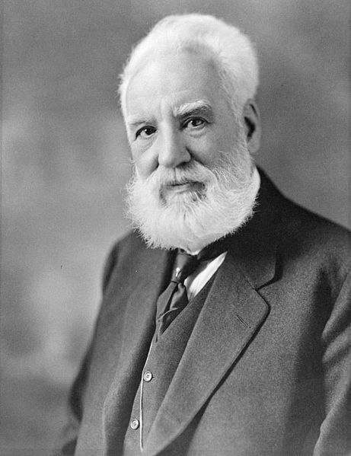
A logarithmic scale for power: The decibel (dB) – a metric of relativity
The decibel (dB) is used to quantify electrical power ratios; i.e.,
a measure of one signal power with respect to another.
Power ratio in dB = 10 log₁₀ (power1/power2)
The gain of an amplifier is commonly expressed in dB:
Bell did not invent the decibel logarithmic unit, it was conceived in Bell Labs and named after him
Alexander Graham Bell (1847–1922) was a scientist, inventor, engineer and innovator who is credited with inventing the first practical telephone
Shamelessly copied
from Wikipedia

Slide 106
Voltage and Current Gain in dB
Power is proportional to voltage squared or current squared, so
Voltage and Current gain is commonly expressed in dB
Voltage
gain:
Current
gain:
Voltage and Current are not power primitives but ratios of them are commonly given on the power scale of dB
> 20log() rather than 10log()
In dB, power gain is not the sum of
voltage and current gains as one may assume prior to more detailed consideration

Slide 107
Gain in dB and its equivalent linear multiplier
3dB
Power gain = 2
voltage (or current) gain = √2
10dB
Power gain =10
Voltage (or current) gain = √10
20dB
Power gain = 100
Voltage (or current) gain = 10
-3dB
Power gain =1/2
voltage (or current) gain = 1/ √2

Slide 108
Two new circuit symbols before we look at the models of amplifiers
The textbook for this unit doesn’t use these symbols
for controlled sources
However, you should know them
Dependent Voltage Source
Dependent sources have ideal
characteristics, yet have an
output parameter which is
dependent on a voltage or current
elsewhere in the circuit
One may add ideal components to
ideal dependent sources to model
practical dependent sources as can
be done for independent sources
Dependent Current Source

Slide 109
Ideal Voltage amplifier
v
v
v_{s}
+
-
i
A
.v
o
vo
i
The ideal voltage amplifier is modelled as an ideal dependent voltage source, the voltage of which is given by the product of the amplifier voltage gain, A_{vo}, and the input voltage, v_{i}
A_{vo}, is called the open circuit voltage gain and is equal to the overall amplifier voltage gain if it is ideal
The ideal case is for infinite input resistance and zero output resistance
No current drawn from source so: Input voltage, v_{i} = Signal source voltage, v_{s}
No series resistance on output so: Load voltage = Amplifier output voltage

Slide 110
Practical Voltage amplifier
R
o
Practical Voltage amplifiers have finite input resistance and non-zero output resistance. The output is a Thévenin Equivalent circuit
v
R
v
I
I
A
.v
o
vo
I
When connected to a non-ideal source (modelled by a Thévenin cct) and a load resistance, the voltage dividers that result lower the overall voltage gain
i_{I}(t)
Amplifier
R_{s}
R_{O}
i_{O}(t)
+
+
v_{s}(t)
+
-
v_{I}(t)
A_{vo}.v_{I}(t)
R_{L}
v_{O}(t)
-
R_{I}
-

Slide 111
The voltage dividers in a practical voltage amplifier reduce the voltage gain
R_{s}
R_{O}
+
+
v_{s}(t)
+
-
v_{I}(t)
A_{vo}.v_{I}(t)
R_{L}
v_{O}(t)
R_{I}
-
-
Input voltage to
the amplifier:
Output voltage
to the load:
So the source-load voltage gain is

Slide 112
Current (and other types of) amplifier
Ideal current Amplifier
i_{I}
i_{s}(t)
R_{s}
A_{IS}i_{I}
An ideal current amplifier will amplify the input current by A_{IS},
the short circuit current gain
It has zero input resistance
It has infinitely large output resistance
The output is modeled by an ideal dependent current source
There are amplifiers designed to amplify input voltage to output current
> Transconductance amplifiers > I_{o}=V_{i} x G
and amplifiers designed to translate input current into output voltage
> Transresistance amplifiers > V_{o}=I_{i} x R

Slide 113
Practical current amplifier
The practical version of the current amplifier has a finite input resistance and an output circuit modeled by a Norton Equivalent Circuit
The source is also modeled by a ‘NEC’
i_{I}
R_{I}
R_{O}
A_{I}i_{I}
The current dividers in a practical current amplifier reduce the current gain
R_{s}
i_{I}(t)
i_{O}(t)
+
i_{s}(t)
⁭
A_{IS}I_{i}(t)
R_{O}
R_{L}
v_{O}(t)
R_{I}
-

Slide 114
Amplifier output distortion: clipping
Positive rail
E⁺
+
+
Max signal range
0V
V_{in}
V_{out}
-
-
E⁻
negative rail
V_{out}
Amplifier input range
=V_{in,max}- V_{in,min}
V_{out,max}
V_{in}
V_{in,min}
V_{in,max}
Amplifier output range
=V_{out,max}- V_{out,min}
V_{out,min}

Slide 115
Increased clipping makes sine waves tend towards square waves
When the signal amplitude exceeds power supply voltage, clipping occurs
Vmax
voltage
t
0
Vmin
Harmonic-related content is added to the signal by the ‘shaping’ action of the clipping
Amplitude
Sine wave
without clipping
f
f₀
2f₀
3f₀
4f₀
5f₀
6f₀
7f₀

Slide 116
Learning Activities for this section
Assigned Reading
Chapter 6, sections 6.2, 6.3, 6.6
make sure you can follow examples 6.1, 6.6, 6.8
Exercises: 6.6, 6.7, 6.16, 6.20
(answers in Appendix E)

Slide 117
Amplifiers (continued) and Filters (start)
Section 07
Differential amplifiers
Strain gauge and Weatstone bridge
Cascaded amplifiers
Efficiency of amplifiers
Filters:
The need for filters
The types of filters in
the frequency domain
Learning Activities for
this Section
Assigned Reading:
Chapter 6, sections 6.8, 6.9
Exercises: 6.22, 6.27, 6.28

Slide 118
Differential Signals
v
2
Commonly, the information content of interest is conveyed in the small difference of two signals (voltages), V_{D}
The small voltage difference, V₂-V₁, must be amplified to be observed
D
v
1
V_{D}
v
v
v
2
2
CM
D
Differential-mode signal: the difference between two signals, V_{D}
Common-mode signal: the average value of two signals, V_{CM}
v_{D,i}
V_{D,o}
For this, a differential amplifier is used
The output may be either differential or single-ended
v_{D,i}
v_{o}

Slide 119
Strain Gauge interface with a ‘Wheatstone Bridge’
Strain Gauge: ‘Gauge Factor’, F :
ε is the strain
V₁
Set all resistors to R₀ , the nominal
(zero strain) resistance of the gauge
R₀
When ΔR (the change in gauge resistance)
is small:
R₀
R₀
Example : R₀=10Ω, ΔR =100μΩ, V₁=1V,
> ΔV ~ 10⁻⁵ Volts
Which will need amplifying prior to processing

Slide 120
High input resistance differential amplifier
V₁
Ideal differential
voltage amplifier:
R=R₀+ΔR
R₀
A_{d} : differential-mode gain
A_{d}
V_{out}=A_{d}×ΔV
R₀
R₀
The input resistance of the differential amplifier must be very high for this application
Any current drawn into the amplifier input will destroy the balance in the Wheatstone Bridge
Any appreciable amplification applied to the common-mode input will swamp the differential output and so must be avoided

Slide 121
Cascade amplifiers for additional gain
Higher gain can be obtained by cascading amplifiers
All high-gain amplifier modules have many internal stages
e.g., an Operational Amplifier has at least three stages and at least 80dB of voltage gain
A₁
A₂
A₃
A is the overall voltage gain
A_{n} is gain of stage n as it is connected in the chain i.e., with
the source resistance of the previous stage and the load resistance
of the next stage taken into account

Slide 122
Source-load resistance in a cascade amplifier
Amp1
Amp2
R_{s}
R_{O}
R_{O}
+
+
+
+
-
v_{I}(t)
+
-
Av_{I}(t)
R_{L}
v_{II}(t)
+
-
Av_{II}(t)
R_{L}
v_{O}(t)
-
R_{I}
-
-
The input resistance of amplifier (n) forms the load resistance of amplifier(n-1)
The ‘usable gain’ is the ‘loaded gain’ rather than the ‘open circuit gain’
Many amplifier modules have a specified gain under specified source and load resistance value (or value range)

Slide 123
Efficiency of amplifiers
An amplifier attains energy by taking current from fixed-voltage power supplies.
Total energy-in must equal total energy-out
V⁺
I⁺
Power (energy/time) into the amplifier:
Heat
P_{in} + I⁺V⁺ + I⁻V⁻
(input signal Power + power supply Power)
P_{in}
P_{out}
I⁻
(I⁻ and E⁻ being negative give
positive power)
V⁻
Power out of the amplifier onto the load:
P_{out}
The efficiency of amplifier is defined as
P_{in} is usually << P_{out}
The rest of the energy is almost always dissipated as heat

Slide 124
Amplifiers: summary
An amplifier is characterised by its gain
Power gain, Voltage gain and Current gain
Ideal amplifiers can be modelled as an ideal dependent source
The output and input of an amplifier can be either current or voltage - 4 combinations give 4 types
In this unit, we are concerned with Voltage and (to a lesser extent) Current Amplifiers and not the other two types
Non-ideal amplifiers have finite input and output resistance values
When connected to non-ideal source and a load, a reduction of gain will result compared to an ideal source and no load
Use Thévenin for voltage amplifiers and Norton for current amplifiers

Slide 125
Amplifiers: summary cont.
Range:
Maximum range is limited by clipping
Cascaded amplifiers:
High gain can be obtained by cascading
Source and load resistances in a cascade chain must be taken into account
Efficiency of amplifiers:
Amplifiers dissipate energy as heat alongside increasing the signal power

Slide 126
Filters
Suppress noise and interference from those parts of the frequency spectrum which are not of interest
Enable multiple ‘channels’ of information on the same signal line, separated in the frequency domain

Slide 127
Noise suppression
The key parameters of Noise in an electrical system:
It is the random fluctuations of voltage or current
Noise occurs at all frequencies with equal probability
(although there is an additional natural phenomena generating nose at ‘low’ frequency)
Power per hertz
P_{N}=S_{N} X BW
t
P_{S}
BW of system
t
S_{N}
Signal power, P_{s}, is
the same in both cases
f₀
frequency

Slide 128
The need to limit bandwidth of signal
Spectrum of speech
Total system
bandwidth
Frequency
For each signal, the information is contained within a limited range of frequency (bandwidth)
Systems often provide more bandwidth than a single channel of signal
It is, therefore, possible to support more than one channel of signal in a system if its bandwidth is appreciably higher than a single channel

Slide 129
Separating one signal from many signal channels
filter
…
frequency
3.4kHz
3.4kHz
3.4kHz
3.4kHz
3.4kHz
3.4kHz
The channels in a multi-channel system may be isolated using filters – one per channel
Other channels must be sufficiently suppressed, because to the targeted channel, anything else is interference
Frequency translation techniques are used to move signals around in the frequency domain

Slide 130
Types of filters
Low-pass filter
Allows signals ranging from 0 Hz (DC) up to a certain ‘cut-off frequency’, f_{c} , to pass
High-pass filters
Allows signals above a certain ‘cut-off frequency’ , f_{c} , to pass
Band-pass filters
Allows signals of a certain frequency range [f₁, f₂] to pass
Band-stop filters
Stops signals of a certain frequency range [f₁, f₂] from passing
Filters are described in the frequency domain
Filter characteristics are defined by a
frequency domain transfer function, H(f)
A component of a signal in the frequency domain is a single-frequency element of it

Slide 131
Frequency domain transfer function
H(f) is usually a complex function
V_{out}(f) is the spectrum of the output signal voltage
V_{in}(f) is the spectrum of the input signal voltage
We are going to use the complex number theory
to which you were introduced in Engineering Mathematics in Weeks 2-4:
review this if necessary
WARNING
WARNING

Slide 132
Amplitude and phase response of a filter
H(f) is usually a complex function and so it has a magnitude part and a phase part
These ‘parts’ are known as ‘responses’
A particular transfer function will have a particular affect on the amplitude and phase of a signal component as it passes from input to output. This affect is dependent on the frequency of the signal component
Amplitude response
phase response
In this unit, we are primarily concerned with the amplitude response of a system (or filter) and less concerned with the phase response

Slide 133
Amplitude and phase response of a filter
Plotting the amplitude response on a log-scaled frequency axis and a dB-scaled (also a logarithmic scale) amplitude axis gives convenient straight line-approximations to the spectral shape of the transfer function

Slide 134
Filter: Low-pass
20log(|H(f)|) (dB)
f_{c}
frequency
(log scaled)
Low-pass filter: allowing low frequency components to pass, rejecting the high frequency

Slide 135
Filter: High-pass
20log(|H(f)|) (dB)
f_{c}
frequency
(log scaled)
High-pass filter: allowing high frequency components to pass, rejecting low frequency components

Slide 136
Filter: Band-pass
20log(|H(f)|) (dB)
frequency
f₁
f₂
(log scaled)
Band-pass filter: allowing a band of frequency components through, rejecting higher and lower frequency components

Slide 137
Filter: Band-stop
20log(|H(f)|) (dB)
frequency
f₁
f₂
(log scaled)
Band-stop filter: rejecting a band of frequency components, letting through higher and lower frequency components

Slide 138
Filters (continued)
Section 08
Filter specifications
Reactive components
Capacitors
Inductors
Frequency domain amplitude response
Transfer function
Cascading filters
Band-pass
Improved transition
Assigned Reading and Exercises
Reading:
Chapter 15: Sections 15.1, 15.2, 15.4.1, 15.4.2
Chapter 17: Sections 17.1, 17.2, 17.7
Make sure you can follow examples 15.1 – 15.4 and 17.1
Exercises: 15.2, 15.4, 15.14, 15.15, 15.17, 17.6

Slide 139
Filter Specifications
|H(dB)| - (magnitude of transfer function)
Pass-band fluctuations
Stop band rejection ratio
Ideal
shape
Pass band
Transition band
Stop band
Frequency
Pass band fluctuations: Filter amplitude (and phase) is variable in the pass-band
Stop band rejection ratio: The amount ‘out-of-band’ signals are suppressed
Transitional slope: The rate (in the frequency domain) of the filter ‘roll off’
Filters also have a phase response, which we are not concerned with in this unit
High rejection ratio and high-rate transition slope filters are more complicated
The process of designing a filter satisfying above requirements is called synthesis
There are several methods available for the synthesis of a filter

Slide 140
Frequency-dependent Impedance is required in to realise a filter
Resistors respond equally to all frequencies: Ohm’s law
The impedance of a resistor is constant for all frequencies, so we can also write
‘Impedance’ is the general complex form of resistance. In the case of a resistor the impedance is purely real
We will see that the impedance of a capacitor is purely imaginary and negative and that the impedance of an inductor is purely imaginary and positive
We will also see that the magnitude of the imaginary impedance of these components depends on frequency
The waveforms of voltage and current associated with a resistor differ only in amplitude
v(t)=R × i(t)
V(f)=R × I(f)

Slide 141
Capacitors and Inductors
A resistor dissipates energy in the form heat
A capacitor stores energy in the form of an electrical field
An inductor stores energy in the form of a magnetic field
C: capacitance (Unit: Farad)
L: inductance (Unit: Henry)
This ‘storage’ capability separates the phases of current and voltage waveforms associated with Capacitors and Inductors by 90º (next slides)
To DC (non-varying) current: a capacitor is an open circuit and an inductor is a short circuit

Slide 142
The Capacitor
Charge, q, accumulates on the plates of a capacitor as current (the flow of charge) is passed to it
This results in a voltage, v, which is proportional to the accumulated charge
The constant of proportionality is the inverse of C, the capacitance of the capacitor
i(t)
Capacitor of
capacitance = C
holding a
charge = q
v(t)
Unlike resistors, the voltage across a capacitor at any moment is dependent on the history of current flowing through it

Slide 143
The Capacitor
Given that the voltage across a capacitor is proportional to the time integration of current, it can also be said that current is proportional to the time derivative of the voltage
If a DC (non-varying) voltage is applied, there is no current. Therefore, capacitors have infinite impedance at DC (0Hz).
Before the next slide: recall a little maths regarding
sine and cosine functions:

Slide 144
Capacitor current in response to sine voltage waveform
A sine wave voltage is applied across a capacitor C:
The resulting current is:
i(t)
The current is also a sine wave, but
It is phase shifted: leading the voltage by a phase shift of 90º
Its amplitude is proportional to the angular frequency, ω, and the capacitance, C
~
v(t)

Slide 145
Charge and discharge
π/2
π
3π/2
2π
i
v
i(t)
ωt
~
v(t)
charge
discharge
charge
in opposite
direction
discharge
from opposite
direction

Slide 146
Phasor diagram and complex notation
imaginary
These phasors represent the voltage and current associated with a capacitor They are always 90º apart and their rotation may be ignored
I_{p}=CV_{p}ω
90º
real
V_{p}
We can place voltage and current phasors in the complex plane, e.g., V_{p} on the real axis and I_{p} on the imaginary axis. So for capacitors we may write
Or

Slide 147
Capacitive Reactance
According to Ohm’s Law, the ratio of voltage to current is impedance (the general complex form of resistance). In the case of a capacitor, the impedance is purely imaginary (called ‘reactance’) and negative
X_{C} is called the capacitive reactance, which has the units of Ω, is purely imaginary, negative and decreases
with frequency
Im
R
Re
X_{c}

Slide 148
The Inductor
Noting that an induced magnetic field is proportional to current flow:
The application of a sine current waveform to an inductor results in a similar, yet opposite, equation for inductive reactance
Inductor-created reactance is known as the ‘Dual’ of capacitor-created reactance
Capacitor
Inductor
Im
X_{L}
R
Re
X_{L} is called the inductive reactance, which has the units of Ω, is purely imaginary, positive and increases with frequency
X_{C}

Slide 149
The Frequency Response of an RC circuit: Transfer function
I
R
+
+
X_{C}
V_{C}=V_{o}
V_{i}
-
-
V_{o} or V_{C} as a fraction of the source voltage, V_{i} ,is (recall the voltage divider):
H(ω) is the frequency domain transfer function of this network with V_{i} as the input and V_{o} as the output.

Slide 150
Amplitude part of the frequency domain transfer function, |H(ω)|
The complex H(ω) may be split into
amplitude and phase responses
of primary interest is the Amplitude Response
For completeness
(but of little use to us)
is the amplitude response
is the phase response
ω_{c} is called the corner (cut-off or critical)
angular frequency
We define:
rad/second
f_{c} is the corner (or cut-off
or critical) frequency

Slide 151
Amplitude part of the frequency domain transfer function, |H(ω)|
Linear
When ω=ω_{c} (or f=f_{c}) we have
|H(ω_{c})| = 1/√2 = 0.707
Which equates to the 3dB bandwidth (half power point)
|H|_{Max}=1
|H|_{Min}=0
Linear
Note how a curved response shape is observed with linear-scaled amplitude and frequency
The amplitude response reduces as frequency increases, and so this is a low-pass filter
ω_{c} (=1/RC) is an important parameter of this circuit
RC has the dimension of time, and is called the RC time constant

Slide 152
Plot of amplitude response (the magnitude part of the frequency domain transfer function)
In dB:
At low frequencies, ω<<ω_{c} : |H(ω)| ~ 1, or in decibels, 0dB
When ω=ω_{c} : |H(ω)| = 1/√2 or -3 dB (very nearly). ω_{c} is the 3-dB bandwidth
At frequencies ω>>ω_{c} :
The high-frequency amplitude reduces at a rate of:
20dB for a frequency increase of 10 times (20 dB per decade)

Slide 153
Log-scaled Plot of amplitude response: dB Vs. Log(ω)
V_{o}/V_{i}
20Log|H(ω)|
(dB)
0.01ω_{c}
0.1ω_{c}
ω_{c}
10ω_{c}
100ω_{c}
1
0
- 3
ω (Log scale)
- 10
Low-pass
Filter
-20 dB/Dec
- 20
1/10
- 30
- 40
1/100
Commonly, the engineer doesn’t worry about the actual response (hatched line) and approximates the shape of the filter by the convenient straight lines on the log-scaled plot, noting that the actual response is 3dB less at ω_{c}

Slide 154
CR filter magnitude response
+
+
C
R
V_{i}
V_{o}
-
-
Establish the Amplitude part of the frequency domain transfer function, |H(ω)|, of this network
Establish the cut-off frequency ω_{c} (or f_{c})
Plot the straigt line approximation of the log-scaled amplitude response

Slide 155
LR filter magnitude response
L
+
+
V_{i}
R
V_{o}
X_{L}=jωL
-
-
Establish the Amplitude part of the frequency domain transfer function, |H(ω)|, of this network
Establish the cut-off frequency ω_{c} (or f_{c})
Plot the straigt line approximation of the log-scaled amplitude response

Slide 156
Cascading Filters
filter1
Buffer
filter2
H
Log(f)
Band-pass and band-stop filter characteristics can be created by cascading filters
The example shows a band-pass filter made by cascading a low-pass and a high-pass filter
Caution: loading effect. The output impedance of the first and the input impedance of the second filter will change their respective frequency responses
A buffer amplifier can be used to eliminate the loading effect:
Input impedance very high so filter1 has near-infinite load resistance
Output impedance very low, so filter2 is driven by near-ideal voltage source

Slide 157
Cascading Filters
H
Log(f)
A further example of cascading filters:
a steeper transition from pass band to stop band
The decibel magnitude axis on which the amplitude responses of filters are presented offers a key convenience when establishing the overall response of a cascade of (buffered) filters
The engineer may graphically add the individual amplitude plots to find the overall filter shape
In the linear voltage domain, the frequency-dependent gains must be multiplied, but this is translated to an addition in the decibel domain and so graphical addition is possible
The log-scaled frequency axis maintains the convenient straight lines

Slide 158
The Operational Amplifier
Section 09
Op-amp model
Four op-amp circuits
Buffer
Non-inverting amplifier
Inverting amplifier
Differential amplifier
System example leading to the design of a differential amplifier
Summary of points covered in these lectures
Assigned Reading and Exercises
Reading:
Chapter 8: Sections 8.1-8.3, 8.4.1-8.4.3
Make sure you can follow examples 8.1 and 8.2
Appendix C: scan read, you don’t need to understand all of these circuits, but you need to appreciate that there are many uses for the op-amp in analogue systems
Exercises: 8.4 - 8.6, 8.9, 8.10, 8.12, 8.14
( you don’t need to do the derivation in Ex 8.14)

Slide 159
Repeated from Section 6: We explore this ‘special’ amplifier
An voltage amplifier may have either a differential or single-ended input and either a differential or single-ended output
v_{i}(t)
v_{o}(t)
Single-ended signals (voltages varying in the time domain) must be referenced to the common system ground
v_{d,i}(t)
V_{d,o}(t)
v_{d,i}(t)
A special type is the Operational Amplifier (op-amp)
Which has a differential input, single-ended output and a huge amount of gain
v_{o}(t)
The gain of an op-amp is so large, the engineer assumes it to be infinite

Slide 160
Operational Amplifier (op-amp): A universal tool for analogue signal processing
V_{o}= A_{v} .(V₊-V₋)
A differential-input amplifier with
the following characteristics
Voltage gain, A_{v}, is infinitely large
Input resistance is infinitely large
Output resistance is exactly zero
Output voltage is A_{v} times the
difference of the input signals, (V₊-V₋)
-
V₋
+
V_{o}
V₊
This set of characteristics is, of course, impractical; However, as an
engineering (99.9%) approximation, they describe the operation well enough
and can be assumed to be true
These characteristics lead to the circuit model shown on the right. The two inputs have no load resistance (open-circuit) and the output is an ideal dependent voltage source (zero resistance)

Slide 161
Operational Amplifier (op-amp): Open-loop and closed-loop operation
V_{o}= A_{v} .(V₊-V₋)
In this ‘open-loop’ mode it can only perform one function:
Decision Making
If V₊ > V₋ , then V_{o}=Max Positive Voltage
If V₋ > V₊ , then V_{o}=Max Negative Voltage
It is used in this mode in decision making circuits (e.g., Analogue-to-digital conversion)
You will see this in the Digital part of this unit
-
V₋
+
V_{o}
V₊
In analogue circuits we use it in closed-loop mode; i.e.,
With feedback – a connection from output to input
This feedback connection is always from output to the inverting input
The inverting input is identified by the ‘-’ on the symbol and the non-inverting input is identified by the ‘+’

Slide 162
We shall examine the following useful circuits as sub-systems in an electronic system
(a) (b) (c) (d)
Circuit (a): Voltage buffer (sometimes called voltage follower)
Circuit (b): Non-inverting voltage amplifier
Circuit (c): Inverting voltage amplifier
Circuit (d): Differential voltage amplifier
There are many analogue operations which may be performed using this core device; including summers, and if reactive components are included, filters and oscillators
Note that (a resistor)

Slide 163
Voltage Buffer (or voltage follower, or unity gain buffer)
There are three ways to consider how the operational amplifier works when placed in a circuit:
The formal way, using control theory and stability analysis – not for us
The ‘it just does’ way – useful for us
The ‘follow the feedback’ way – useful for us
Way (1): ignore, it is not useful to us
Way (2):
Assume the amplifier is part of a system with balanced power supply of +/- V_{supply}
Assume V_{supply} is something reasonable, e.g., 10V or 15V
V_{I} and V_{o} has to be in the range +/- V_{supply} if the circuit is working properly
The gain of the amplifier is infinite, so if V_{o} is within +/- V_{supply} , the voltage difference at its input must be exactly zero
As the output is connected to one amplifier input and the circuit input is connected to the other, V_{o} = V_{I}

Slide 164
Voltage Buffer (or voltage follower, or unity gain buffer)
The voltage transfer function, G_{v}, of this circuit is 1
which is clearly linear
Way (3):
Set V_{I} to be within the system power supply range of +/- V_{supply} , e.g., +/-10V, +/-15V
Now turn the power supply on to start the subsystem working
If V_{o} (connected to V₋ ) is even slightly more positive than V_{I}, the super-high gain means that the operational equation,
forces V_{o} (very abruptly due to the feedback) to match V_{I}
The same argument applies to the case of V_{o} being slightly more negative than V_{I}
V_{o}= A_{v} .(V₊-V₋)

Slide 165
Voltage Buffer (or voltage follower, or unity gain buffer)
Way(2) and Way(3) of understanding this circuit together give an intuitive understanding of how this infinite gain differential amplifier creates a voltage follower
It is also a ‘Buffer’ because it offers an infinite input resistance and a zero output resistance
This allows for the voltage output of a high resistance source to be observed without loading, and for a low resistance load to be driven
Recall the voltage dividers at the input and output of the voltage amplifier

Slide 166
Non-inverting voltage amplifier
Given the infinite gain (or merely just very very large gain in a practical implementation) even a small amount of feedback will force V₊=V₋
We can always assume that V₊=V₋ if feedback is present
Creating the feedback voltage from the output voltage via a voltage divider circuit means that
V+
V-
The voltage transfer function, G_{v}, of the circuit is given by so
Setting R₂=0 and R₁=∞ creates the voltage buffer circuit and G_{v}=1
Which is frequency-independent and linear

Slide 167
Inverting voltage amplifier
Once again, we can assume that V₊=V₋ if feedback is present
In this case V₊=V₋ = 0
V₋ is held at 0V but is not physically connected to it, this is called a Virtual Earth
Given that both inputs to the op-amp are of infinite resistance (or merely just very very large resistance in a practical implementation), we can say that the current through R1 is the same as that through R2
We may use KCL to write:
And so the voltage transfer function, G_{v}, is
Which is frequency-independent and linear

Slide 168
Inverting or non-inverting amplifier: Choice and gain configuration
The non-inverting amplifier offers:
infinite circuit input resistance
linear voltage gain controlled by resistor values
zero circuit output resistance
The inverting amplifier offers:
controllable circuit input resistance
liner voltage gain controlled by resistor values (of a slightly more convenient form)
zero circuit output resistance
signal inversion in the voltage scale
(for a sine wave this is the same as a 180º phase shift)
This latter point is useful as many of the filters and summing circuits based on op-amps are inverting, so an inverting amplifier is also required to restore the sense of the signal

Slide 169
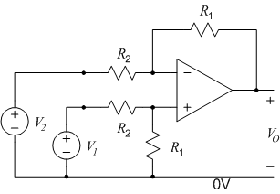
Differential voltage amplifier
It is shown in Chapter 8, Section 8.4.3 (part of the assigned reading for this lecture) that the differential to single-ended voltage transfer function of this circuit is given by
Note that there are two equal-valued resistors, R₁ and two equal-valued resistors R₂
Whilst the operational amplifier itself is a differential to single-ended voltage amplifier, its gain is unusable and uncontrollable
This differential amplifier has a linear gain defined solely by resistor values

Slide 170

A system example
Assume a sensor which gives a small differential voltage output from a high impedance output which suffers from both noise and higher frequency interference
The need is to amplify and extract the desired signal and pass it to a digital processing entity for manipulation
A low pass filter is available as a sub-system but it can’t deliver any current without being detuned (this is the same as stating that it should not be loaded)
If the Vp-p of the sensor is 10mV, the Vp-p of the digital interface is 1V, and the filter has 3dB loss, the gain of the amplifier must be G

Slide 171
A system example
1V p-p required at A/D interface, filter has 3dB loss in passband and sensor gives 10mV p-p output
Vp-p = √2V
Vp-p = 1V
10mV p-p
Filter removes interference and ‘some’ noise
Buffer required to stop current draw from sensor
Buffer required to stop current draw from filter
Differential amplifier
with gain

Slide 172
A system example: the differential amplifier
Choose R2=100Ω
(this stage is preceded by a buffer so this resistance is acceptable)
Therefore, R1=10√2 kΩ
This is about as much gain as the designer would demand from a single stage

Slide 173
Important signal processing functions in electronic systems
Review of topics covered in the Analogue lectures
Amplification: Completed in the Analogue lectures
Filtering: Completed in the Analogue lectures
Interpretation: Ongoing in the Digital lectures
Display: Ongoing in the Digital lectures
Storage: Ongoing in the Digital lectures
Actuation: Covered in part in the Analogue lectures by consideration of low output resistances and amplification of voltage and current for energy delivery. The control and process output aspects is ongoing in the Digital lectures

